Slide 1
Media for all 5 audiovisual translation: expanding borders
Translation for Dubbing:
Expanding Borders
Prof. Frederic Chaume
Universitat Jaume I

Slide 2
1. AUDIOVISUAL TRANSLATION
Revoicing and / or captioning
Revoicing: substitution or addition to the film of a new soundtrack containing the recorded dialogues in the target language
Captioning: addition to the film of a new track containing a written translation of the dialogues (and in some cases, paralinguistic signs, sound effects, songs, etc.)

Slide 3
1.1. TYPES OF AUDIOVISUAL TRANSLATION
Spoken output (SL) > Written output (TL)
Captioning
Revoicing
AVT
Spoken output (SL) > Spoken output (TL)
Notes:
Language transfer of AV texts: there are two main approaches

Slide 4
1.2. Types of AVT: Revoicing
The original soundtrack is totally replaced by a new one in the TL and the target viewer can no longer hear the original exchanges
Revoicing
Lip-sync dubbing
Fandubbing
The translation is overlapped and the original spoken dialogue is still audible in the background
- Voice-over
Interpreting
Free commentary
Díaz Cintas and Orero (2010: 41)

Slide 5
1.3. AUDIOVISUAL TRANSLATION TYPES: REVOICING
dubbing
voice-over
Polish szeptanka
(fiction is not always rendered through dubbing/subtitling)
Russian dubbing / partial dubbing
simultaneous interpreting (+ Tanzanian veejays)
free-commentary
Goblin Translation
audio description for the blind and visually-impaired
fandubbing/fundubbing (amateurs also dub their own clips)
Notes:
Dubbing is a type of Audiovisual Translation [...] consisting of a replacement of the original track of a film containing the source language dialogs, for another track on which translated dialogs in the target language are recorded.

Slide 6
2. MEDIA CONVERGENCE AND AVT: present facts
Media convergence + digital technology allow all AVT types in the same product:
Any audiovisual product, in principle – potentially – can be dubbed, subtitled (or respoken, or audiosubtitled), voiced-over, subtitled for the deaf, audiodescribed for the blind. Some other genres can be translated with free-commentary, can also be fandubbed, fansubbed, etc.
New audiovisual genres combine several AVT Types
videogames (dubbing + subtitling + localization)
advertising & infomercials (dubbing, subtitling, voice-over)
instructional videos, webinars (dubbing + subtitling + voice-over)
We can finally bring technology to its potential:
No more excuses → revoicing and captioning
Media for All

Slide 7
In this new setting...
Which is the situation of dubbing?

Slide 8
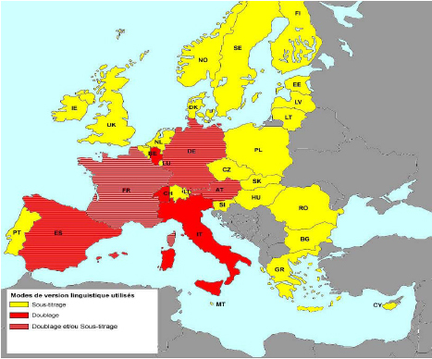
AVT modes on cinema screens in Europe
http://mediadeskpoland.eu/upload/PP_Comite_media_280708_FINAL.pdf

Slide 9
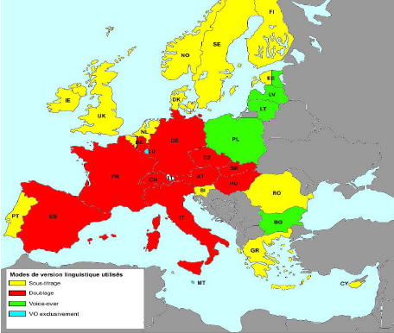
AVT modes on TV in Europe
http://mediadeskpoland.eu/upload/PP_Comite_media_280708_FINAL.pdf

Slide 10
3. SOME INTERESTING TRENDS: DUBBING
Dubbing is used to translate cartoons all over the world: UK
Portugal → Hannah Montana (Chorão 2012); Soundub Lisboa (SDI-Media)
Denmark → The Nutty Professor, Dansk Dub, Det Nye Hovedkvarter
Norway → teen TV series and films (teen pics) (Tveit 2009)
Russia → gradually replacing the once predominant voice-over mode
Greece → South American and Turkish soap operas
the Arab world → South American and Turkish soap operas
some commercials are dubbed even in traditional subtitling countries
fandubbing is becoming internationally popular
DVDs, DTV and digital technology on the web may include dubbings into traditional subtitling languages: Crouching Tiger, Hidden Dragon, spaghetti westerns (dubbed into English)
dubbing is also used to teach foreign languages (Danan, ClipFlair)
Dubbing has also moved into other complex audiovisual translation modes:
in videogame localisation, especially in blockbusters, dialogues are usually dubbed

Slide 11
Some examples
Lucky Star: http://www.youtube.com/watch?v=rrUhIgdLWCw
Hannah Montana: http://www.youtube.com/watch?v=poxEsv0TWnM
Dansk Dub: http://www.youtube.com/watch?v=kMIRiM5WcpY
Russia: http://www.youtube.com/watch?v=Gptp0vqpzG0
Russia – replacing voice-over: http://www.youtube.com/watch?v=HiSmcG2dOU4
South American soap operas: http://www.youtube.com/watch?v=ItrLJ8xnbnk
(Slovak dubbing): http://www.youtube.com/watch?v=V1oMDLmyA7Q
Turkish soap operas into Arabic: http://www.youtube.com/watch?v=ptJedfuGJtM
Commercials: http://www.youtube.com/watch?v=3-LavXsgRlw [IT] http://www.youtube.com/watch?v=4P-nZZkQqTc [EN]
Japan: http://www.youtube.com/watch?v=HBTheJXJEcg
Indonesia: http://www.youtube.com/watch?v=khlIy0OfsmE
Fandub: http://www.youtube.com/watch?v=E-H3K8TK2Vw
VGLOC: http://www.youtube.com/watch?v=9EvP4NWW0T0&feature=related

Slide 12
The Americas
USA
Subtitling
Dubbing to export (their) films abroad
Canada
Subtitling in English-speaking regions
Dubbing in Quebec
Latin America (general trend)
Dubbing on TV
Subtitling in cinema theatres

Slide 13
Asia
Dubbing countries (mixed modes)
Japan, China (into Mandarin Chinese), Vietnam, Philippines, India, Pakistan, Thailand
Taiwan and Korea also use mixed modes
Dubbing and subtitling at the same time (different target languages)
Korea (dubbing on TV)
Indonesia and Malaysia

Slide 14
Survey in Japan, 2009
Source: VLC Co, Ltd. http://www.vlcank.com/mr/report/029/005 (2009)

Slide 15
Survey in Japan, 2009
Source: VLC Co, Ltd. http://www.vlcank.com/mr/report/029/005 (2009)

Slide 16
Survey in Japan, 2009
Notes:
A trend towards localisation

Slide 17
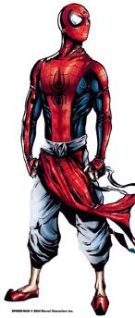
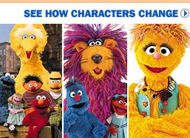
4. A PARALLEL PROCESS: ADAPTATIONS / TRANSCREATIONS (Remakes?)
A combination of globalisation and localisation: Glocalisation
Pavitr Prabhakar (Indian Sp)
PowerPuff Girls
Sesame Street
Notes:
A combination of globalisation and localisation: Glocalization means a case in which a global product is transformed into another shape in order to meet the needs of local consumers.

Slide 18
Glocalisation involves translation
“Once, American entertainment companies exporting characters just dubbed them into other languages. But in recent years, Asia has become the testing ground for character reinvention, a process called "transcreation.” (WSJ)
Glocalization means a case in which a global product is transformed into another shape in order to meet the needs of local consumers.
Notes:
This is also related to remakes in film.

Slide 19
8. RESEARCH UP TO DATE

Slide 20
THEORETICAL GROUNDS
The audiovisual text from a translation viewpoint (Zabalbeascoa, Sokoli, Luyken et al., Bartrina, Zhang… based on Film Studies & Semiotics)
Characteristics and ubication of AVT in TS (Reiss, Bassnett, Snell-Hornby, Hurtado, Zabalbeascoa, Díaz Cintas, Chaume, –concepts–…)
Research methodology (Karamitroglou, Lambert, Díaz Cintas, Díaz Cintas and Remael, Delabastita, Barambones, Martí Ferriol, Pavesi & Freddi…)
Lines of research in AVT (Díaz Cintas, Díaz Cintas and Remael, Bartrina, Mayoral, Gambier, Chaume) and present avenues
AVT History (Izard, Ivarsson, Pommier, Gottlieb, Chaume, Gutiérrez Lanza, Vandaele, Barambones, Díaz Cintas, Ávila, Pereira, Brant, Marleau, Qian, Lee, Viviani, Pruys, …)
Audiovisual landscapes (Gambier, Luyken), practices in other countries and audiovisual cartographies (Barambones)

Slide 21
Professional approaches
Description of professional issues (legal aspects, rates, deontology, market, industrial process, agents…)
Description of translation process (translation, lip-synching, take segmentation, insertion of dubbing symbols, imitation of oral discourse…)
Hesse-Quack, 1969; Fodor, 1976; Pommier, 1988; Luyken et al. 1991, Whitman-Linsen, 1992; Agost, 1999; Chaves García, 2000; Paolinelli & Di Fortunato, 2005; Spadafora, 2007; Jüngst, 2010;
Description of other revoicing types (voice-over –Orero et al., Franco, Espasa, Wright and Lallo, Kotelecka, Rebosz…–, simultaneous interpreting, partial dubbing, videogame localization, audiodescription, fandubbing→crowdsourcing
...and yet to explore in dubbing
Technology and new tools: 3D, 4D, memory tools, automat
New formats and audiovisual genres→ the role of dubbing

Slide 22
FOCUSED ON THE SOURCE TEXT (the process of translation)
Constraints (Titford, Mayoral, Zabalbeascoa, Martí Ferriol…)
Audiovisual Genres (Agost, Luyken, Espasa, Franco)
Pragmatic and discursive approaches (Romero-Fresco, Pavesi, Baumgarten, Martínez Sierra, Richart, Baños, Romero-Ramos)
Prescriptive and contrastive approaches (focused on ‘bad’ translations, translation problems, Alcandre, Gómez Capuz, Garcés, Hart, Whitman-Linsen…)
Quality standards in dubbing (moving from ST to TT): Dries, Chaume, Castro

Slide 23
Focused on the target text (the product of translation) [1]
Filmic adaptations – from novel to film – (Cattrysse, Zatlin, Cañuelo, Alsina, Igareda,Trasvases Culturales)
Polisystemic approaches: influence of dubbing on in-house production, on other dubbings, relationship between source and target cultures, use of dubbed audiovisual products (i.e. TV station, listings, etc.), generation of new audiovisual products based on previous dubbings…
Translation Norms in dubbing (from Goris to Ranzato…). Synchronic or diachronic studies (censorship).
The concept of ‘translation method’ in dubbing (Martí Ferriol, He)

Slide 24
Focused on the target text (the product of translation) [2]
Translation techniques in dubbing (Chaves, Martí Ferriol, Minutella, Chaume…)
Corpus studies (Forlì, Trieste…)
The language of dubbing –dubbese–: oral discourse and language policy (Pavesi, Freddi, Bruti, Minutella, Taylor, Valentini, Forchini, Izard, Baños, Romero-Fresco, Matamala, von Flotow, Barambones, TRAMA, Llengua i Mèdia, CEDIT), neutral languages (Spanish, Portuguese, French)
Filmic approaches and semiotic analysis (Bosseaux, Martínez Sierra, Richart, Chaume, Chaves, Baumgarten, Mubenga, Franzelli, González Vera, ), remakes (Zanotti)
Reception studies (Antonini, Chiaro, Antonini & Chiaro, Espasa, Fuentes, Mayoral…), including audience design (new audiences, new formats, etc.) and social perspectives (Luyken, Zaro). Cognitive approaches: eye-tracking

Slide 25
Focused on the target text (the product of translation) [3]
Translation issues (case studies):
humour (Zabalbeascoa, Chiaro, Bucaria, Fuentes, Martínez Sierra, Martínez Tejerina…)
film titles (González Ruiz, Fuentes, Santaemilia & Soler, Nord…)
songs (Bosseaux, Susam-Sarajeva→ The Translator, 2008)
advertising (Valdés, Jettmarová, Bueno, Duro, Lorenzo & Pereira)
puns, wordplay and idioms (Delabastita→The Translator, Sanderson)
cultural references in dubbing (Franco, Santamaria, Ranzato, Antonini & Chiaro, Valentini, Martínez-Garrido)
intertextuality (Rodríguez Espinosa, Botella)
pornography (Castillo Flores)
taboo language, linguistic variation (Chiaro…)
proper names (Hurtado de Mendoza, Mayoral)
multilingual movies (Heiss, Valdeón, Corrius, de Higes, de Bonis, Monti, Vollmer, Zabalbeascoa)
...

Slide 26
Focused on the target text (the product of translation) [4]
10. The Cultural Turn in AVT (and dubbing)
Díaz Cintas, 2012 → Meta
Books, articles and PhD theses:
gender (De Marco, Mereu, Ranzato, Zanotti)
power and manipulation (Di Giovanni, Richart, Ferrari, Barambones et al., Holobut – voice-over –)
patronage (Marzà, Prats)
...

Slide 27
didactics
Agost, Chaume, Hurtado (1996 & 1999); Zabalbeascoa (1997, 1999, 2000, 2001); Izard (2001); Bartrina & Espasa (2001, 2003); Chaume (2003); Pereira & Lorenzo (2004); Díaz Cintas (2007); Jüngst (2010); Martínez Sierra (2012); Cerezo (2012)
Teaching languages through dubbing (Danan, Burston, ClipFlair)

Slide 28
Some projects involving dubbing

Slide 29
http://137.204.90.125/dubbingquality
Dubbing Quality

Slide 30
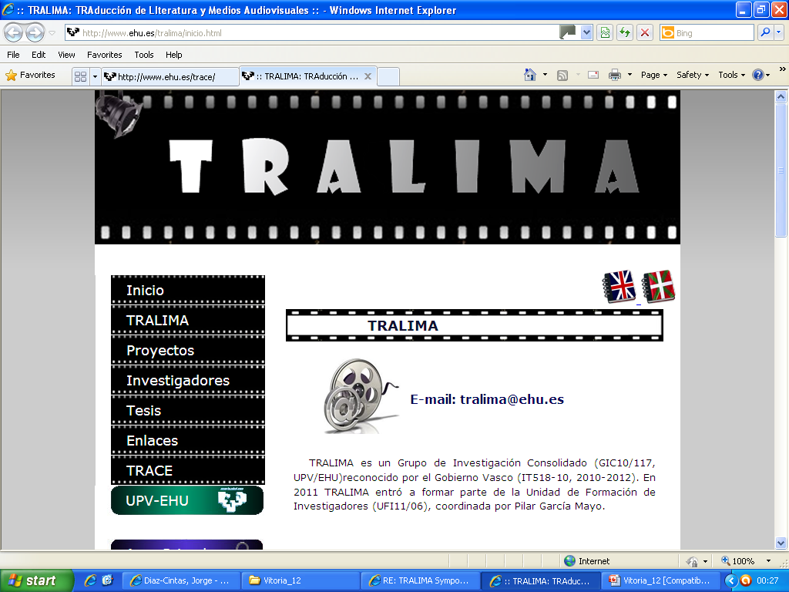
www.ehu.es/tralima
Tralima

Slide 31
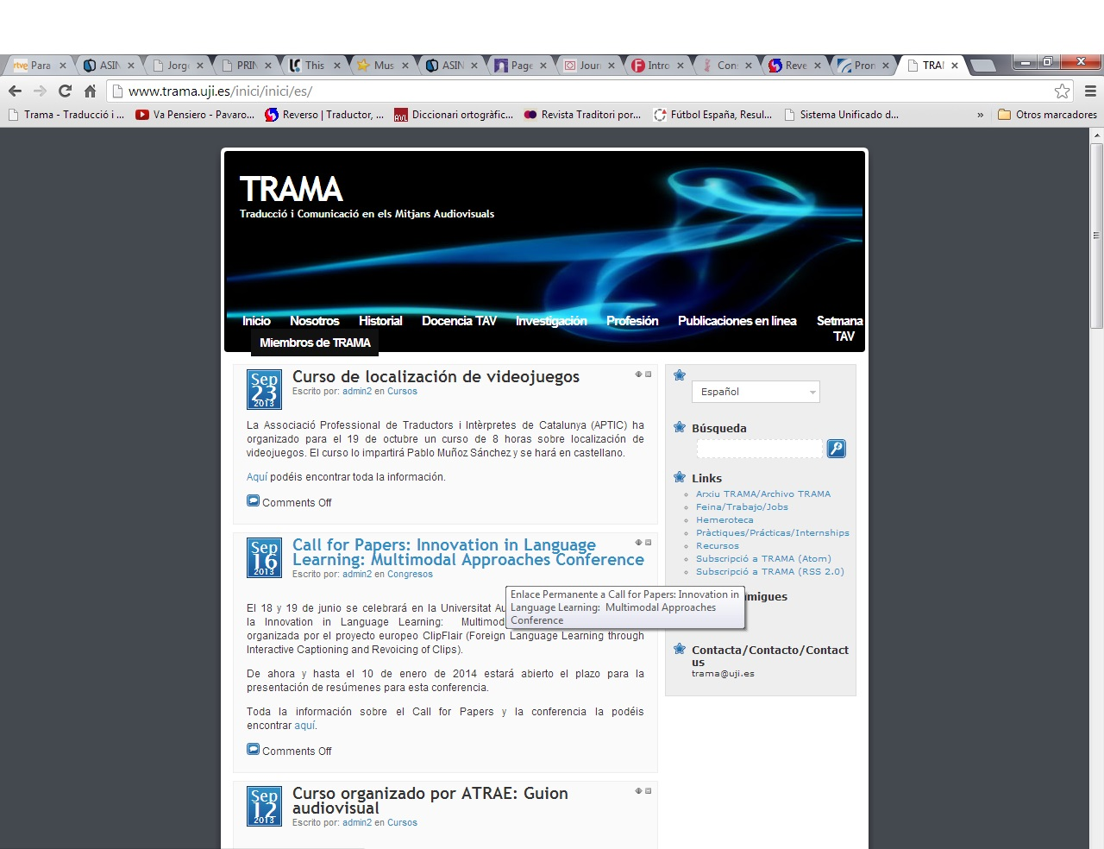

Slide 32
Forlitx

Slide 33
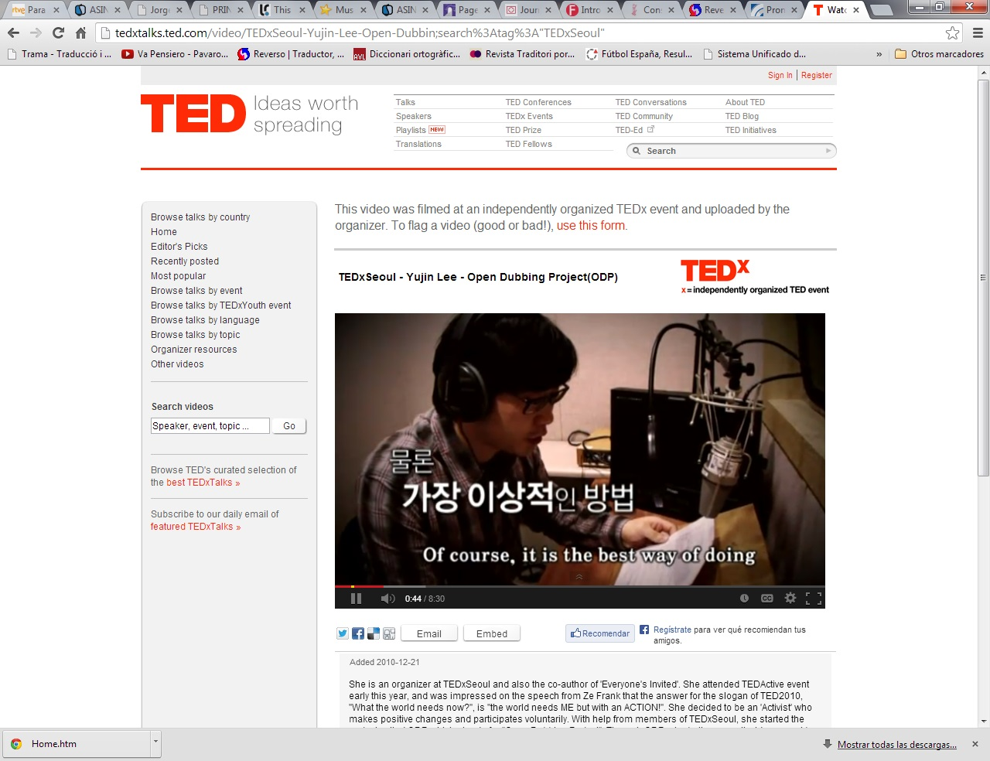

Slide 34
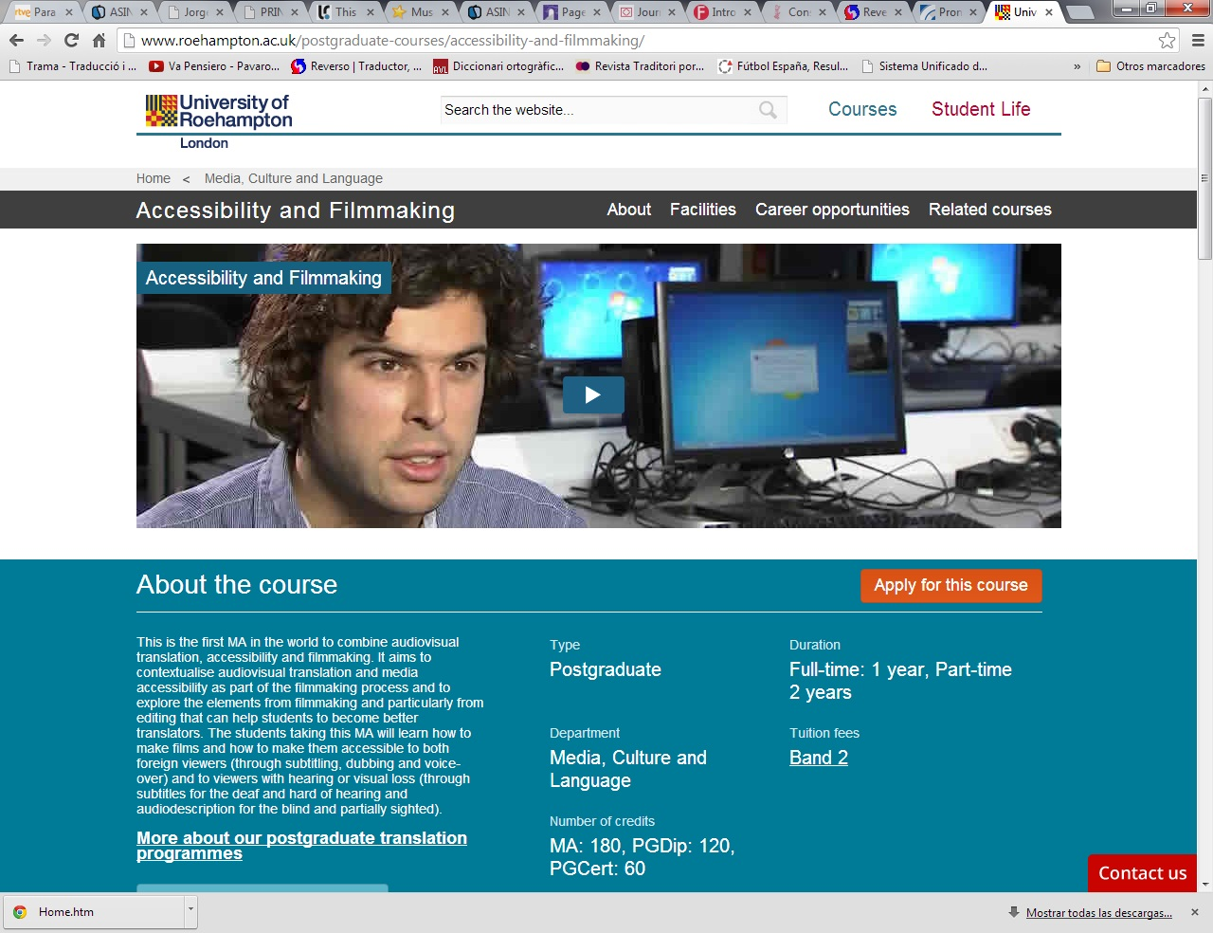

Slide 35
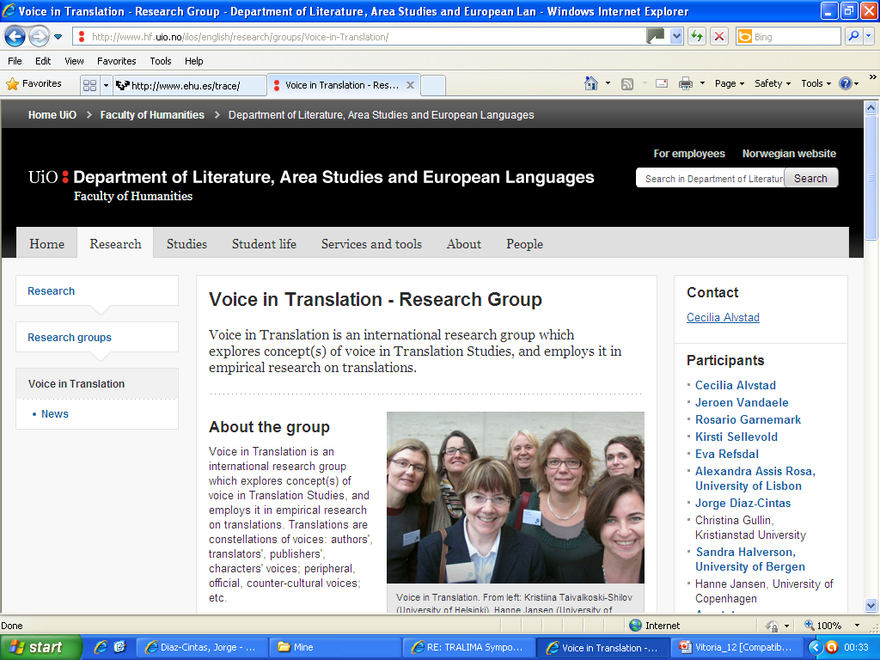
www.hf.uio.no/ilos/english/research/groups/Voice-in-Translation
Voice in Translation

Slide 36
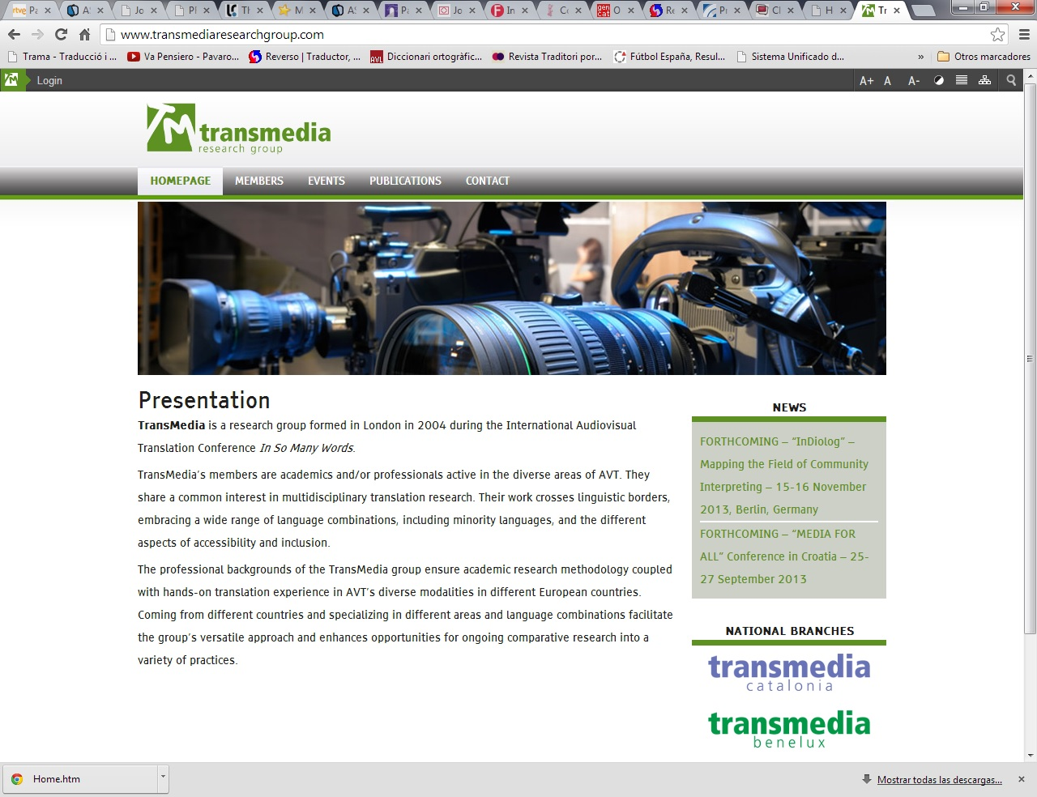

Slide 37
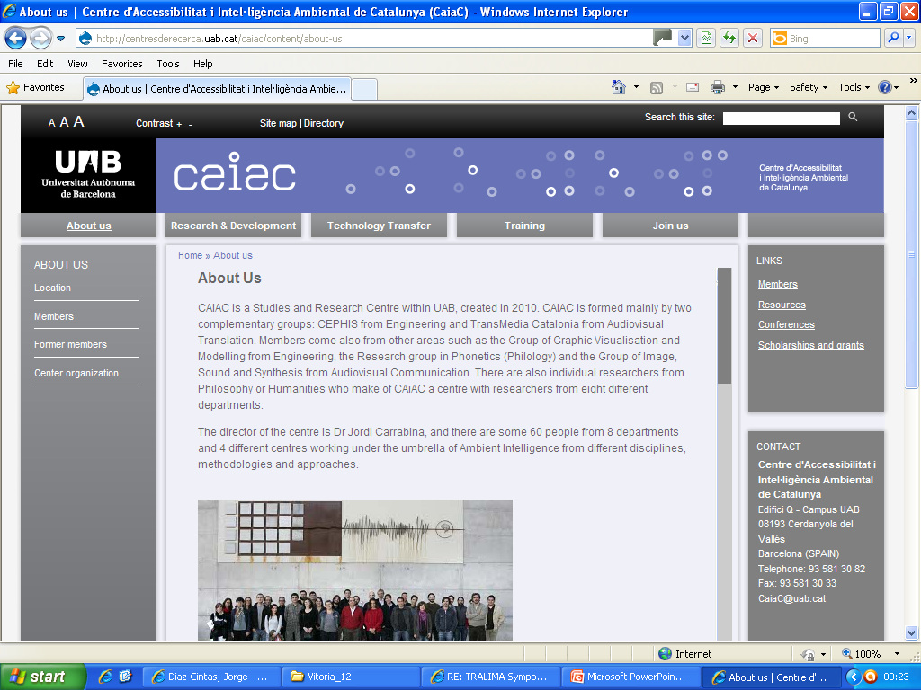
http://centresderecerca.uab.cat/caiac
CAIAC

Slide 39
TRANSLATING MUSIC

Slide 41
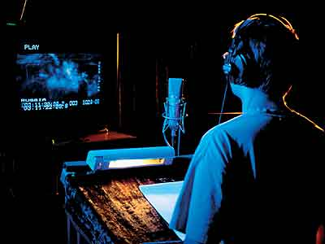
MANY THANKS!!!!

